Slide 1

WEATHER APP
SRM INSTITUTE OF SCIENCE AND TECHNOLOGY
FACULTY OF ENGINEERING AND TECHNOLOGY
DEPARTMENT OF DATA SCIENCE AND BUSINESS SYSTEMS
21CSC206P - Advanced Object Oriented Programming - Project Review 2
Team Members
RA2311027010079 SHIKHAR CHODHARY
RA2311027010104 PRASAD PATIL

Slide 2
Abstract
This project involves the development of a dynamic weather forecasting application using Java in Android Studio that integrates the OpenWeather API. The app provides real-time weather updates such as temperature, humidity, wind speed, and weather conditions for various locations worldwide. Users can search for specific locations to get detailed weather information, including forecasts for upcoming days. The app aims to deliver an intuitive user interface, ensuring ease of use while presenting accurate and up-to-date weather data.
The primary goal of this application is to offer users a reliable tool for weather forecasting with an interactive user experience. By leveraging the OpenWeather API, the app fetches real-time weather data and displays it in a visually appealing format. This solution addresses the need for accurate weather predictions on the go, with the potential for further expansion to include features like severe weather alerts, location tracking, and multi-language support.

Slide 3
Objectives
Real-time weather data: Provide users with up-to-the-minute weather information, including temperature, humidity, wind speed, and current conditions.
Global coverage: Enable users to search for weather updates for any city or region worldwide.
User-friendly interface: Design a simple, intuitive user interface with clean navigation to enhance the user experience.
Weather forecast: Offer a 5-day weather forecast, displaying predicted conditions, temperatures, and other relevant details.
Location-based data: Utilize device GPS to automatically display the weather for the user's current location.
API integration: Effectively integrate the OpenWeather API for fetching and displaying accurate weather data.
Error handling: Implement features to manage network failures or incorrect API responses gracefully.

Slide 4
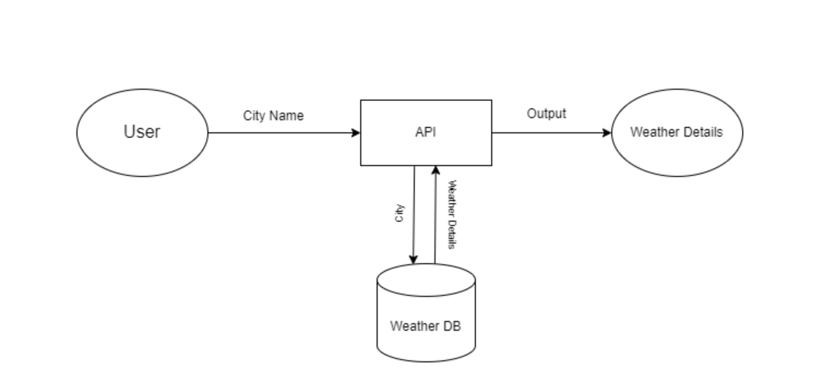
Architecture diagram

Slide 5
Software Requirments
Development Tools:
Android Studio: The primary IDE for Android development.
Java: Programming language used to develop the app.
Gradle: Build tool integrated with Android Studio for dependency management.
Libraries/Frameworks:
OpenWeather API: Used to retrieve weather data. API key required for integration.
Retrofit/Volley: For making network requests to the OpenWeather API.
Gson: For JSON parsing of the API responses.
Picasso/Glide: For loading weather-related images or icons (optional).
Platform Requirements:
Operating System: Windows, macOS, or Linux (for development environment).
Android SDK: Minimum SDK version 21 (Android 5.0 Lollipop) or higher.
Emulator: Android Virtual Device (AVD) for testing or a physical Android device

Slide 6
Software Requirments
APIs and Permissions:
OpenWeather API: For fetching real-time weather data.
Location Services: To detect and display the weather for the current location.
Internet Access Permission: Required to fetch data from the OpenWeather API.
Testing Tools:
JUnit: For unit testing Java code.
Espresso: For UI testing.

Slide 7
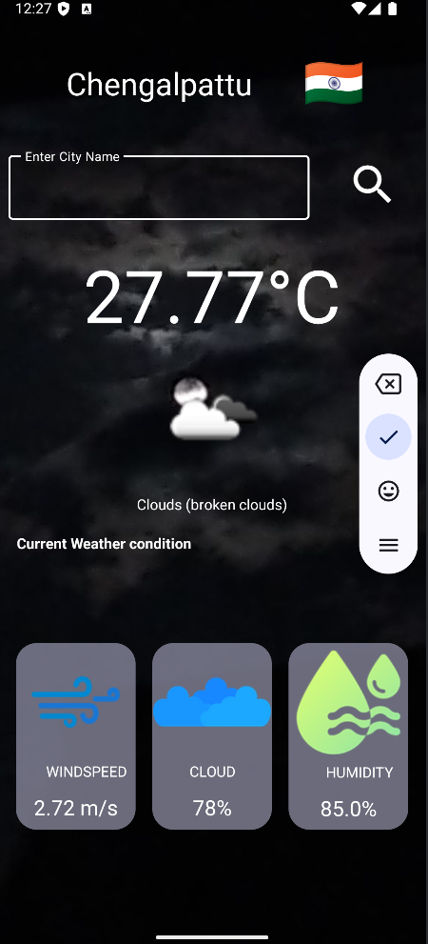
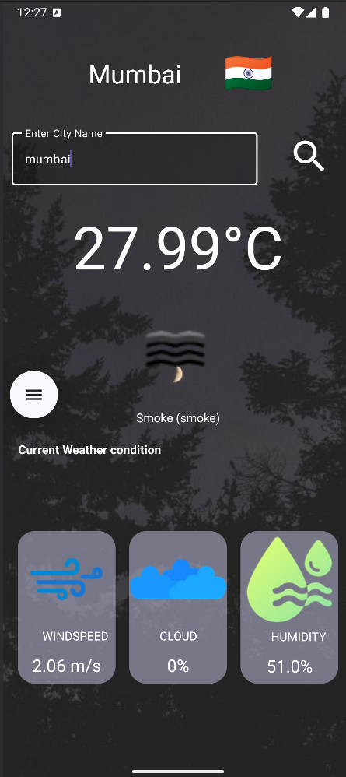
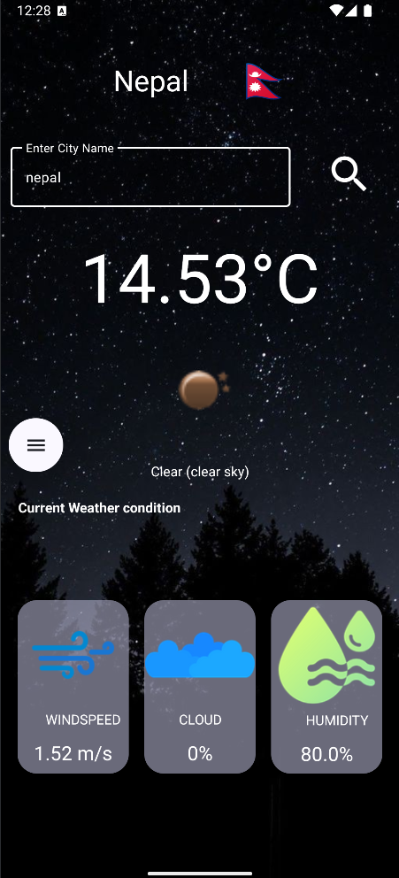
GUI Design

Slide 8
Thanks

